Slide 1

Carlsberg English Concept
- Mobile Version
© 2016, MobileAds. Proprietary and Confidential.

Slide 2
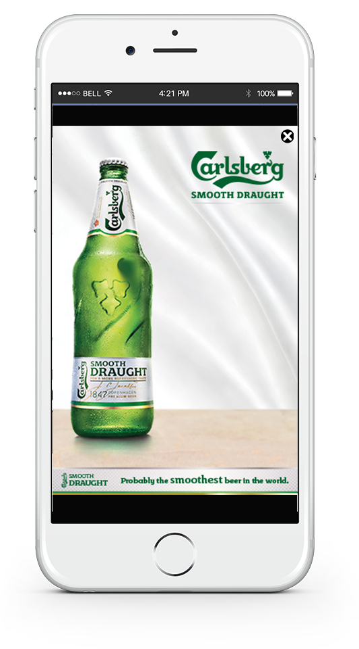
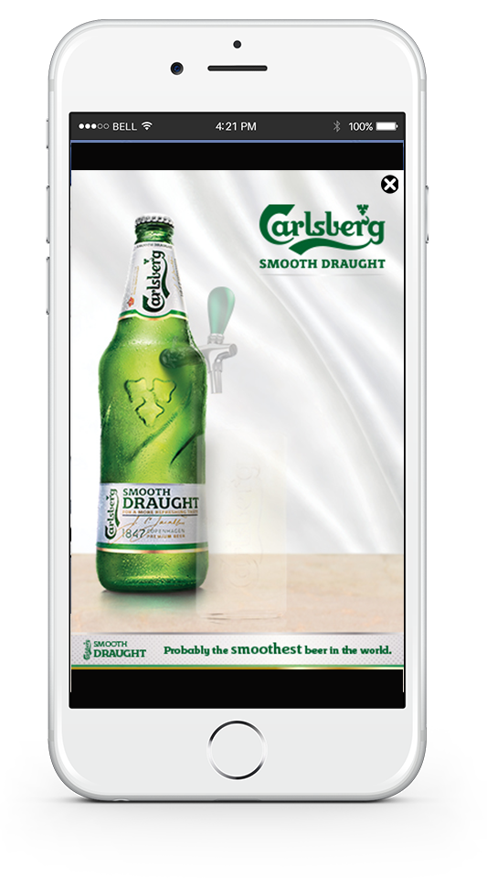


Carlsberg English Concept
Interstitial 320x480 appears. There is bottle and logo image. Glass and nozzle image will slowly appear.
© 2016, MobileAds. Proprietary and Confidential.

Slide 3
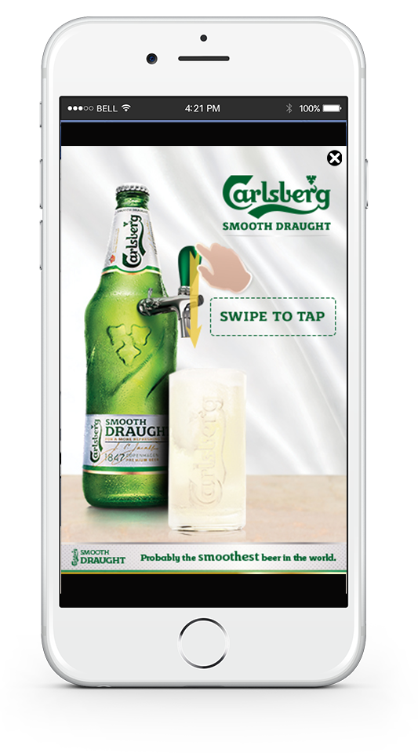
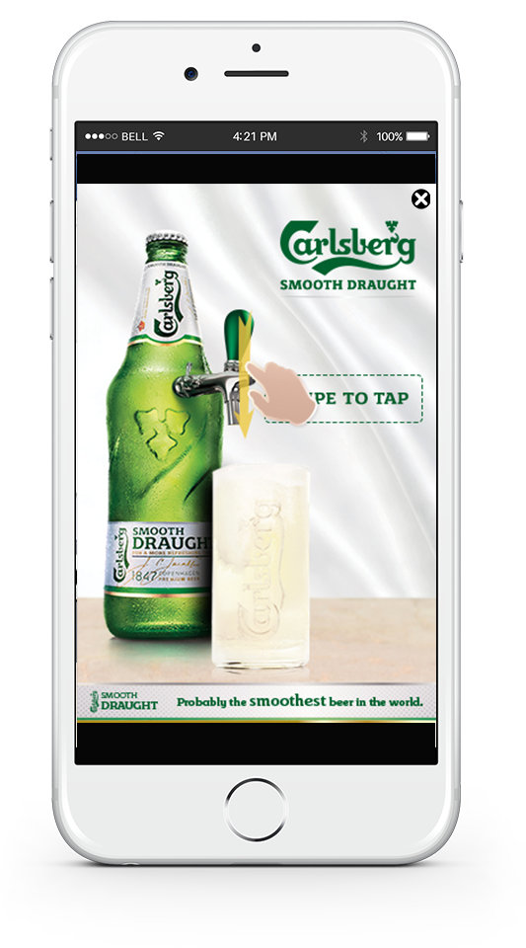

Carlsberg English Concept
Then CTA icon will appear. It’s an animated icon flowing up and down, showing “Swipe Down” gesture.
© 2016, MobileAds. Proprietary and Confidential.

Slide 4
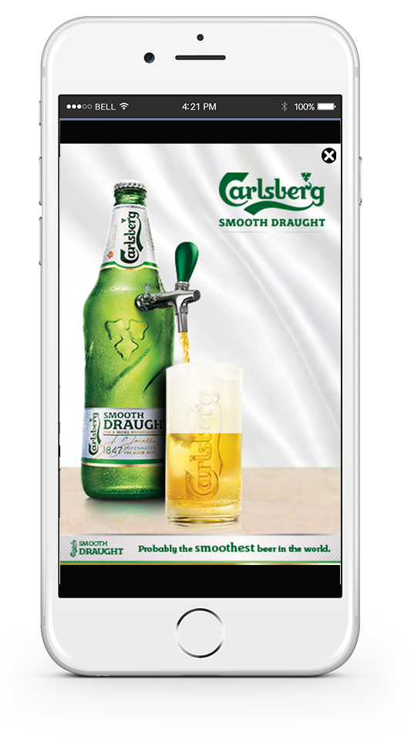


Carlsberg English Concept
User will swipe the screen down to pull down the beer tap, beer is start to be poured. User can hear the sound of the beer pouring.
© 2016, MobileAds. Proprietary and Confidential.

Slide 5
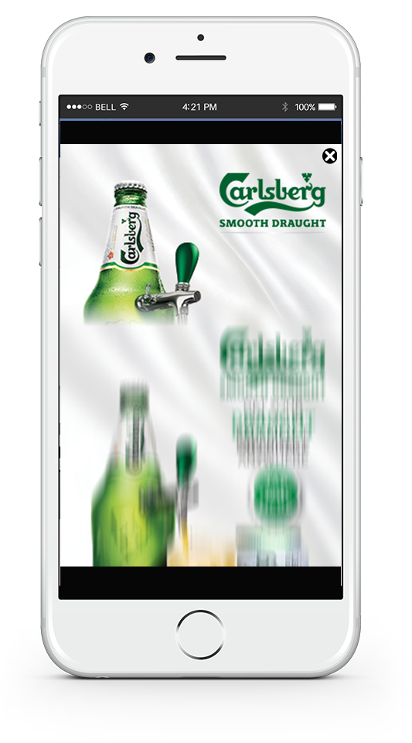
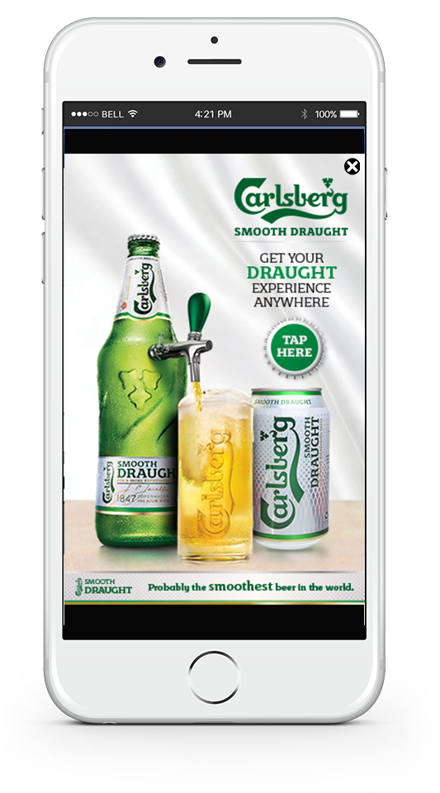
Carlsberg English Concept
After the glass is full, it start to stop pouring. Last screen will appear moving from the bottom to top.
© 2016, MobileAds. Proprietary and Confidential.

Slide 6
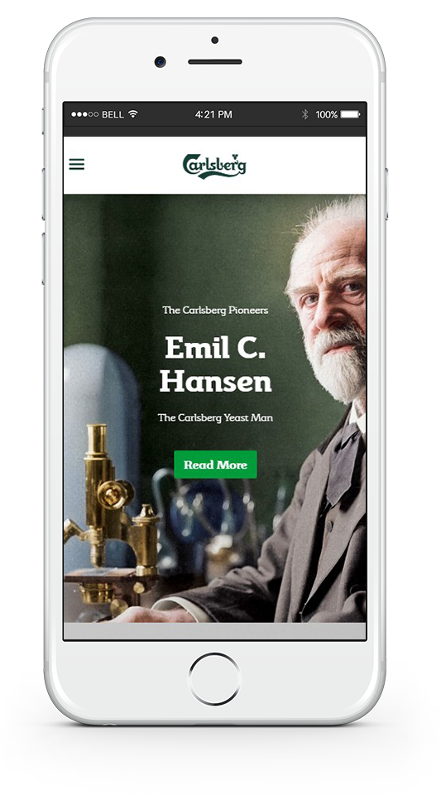
Carlsberg English Concept
Tap on the CTA button will direct user to the landing page.
© 2016, MobileAds. Proprietary and Confidential.

